Slide 1
WORLD-CL S BATTERY MANUFACTURER
November 2024
Energy Storage System Products and Solutions
Guangzhou Great Power Energy & Techn logy Co., Ltd. ( Headq arters ) Address: No. 912 Shiliang Road, Shawan town, Panyu, Guangzhou, China
^{G}Ad^{u}dªr^{n}e^{g}s^{z}s^{h}: ºR^{u}oo^{G}m^{rea}0^{t}03^{P},ºN^{w}o^{e}4^{r} 1E9^{ne}Q^{r}i^{g}n^{y}g^{S}sh^{to}a^{r}R^{ag}o^{e}ad^{T},^{e}D^{c}o^{h}ngc^{lo}h^{g}o^{y}n^{C}gºt.o, w^{Lt}n^{d},.Nansha,
Instagram LinkedIn Youtube Facebook Twitter Pinterst
Search : Great Power
Guangzhou, China
^{T}W^{e}e^{l:}b⁺s⁸it⁶e: ⁰w²w⁰ w³⁹.g¹r⁹ea⁶t⁸p⁸o⁸wer.net/en
Guangzhou Great Power Energy & Technology Co., Ltd.
Email: sales@greatpower.net
Guangzhou Great Power Energy Storage Technology Co., Ltd.

Slide 2
CONTENTS
^{G}Sto^{R}ck^{E}C^{A}od^{T}e：^{P}30^{O}043^{W}8, CEh^{R}ina
COMPANY PROFILE
01~14
15~40
41~46
PRODUCTS INTRODUCTION
REFERENCE PROJECTS
E²sta⁰bl⁰ish¹ed
10,000+
Over 10，000
1,600,000m
2
9
employees
Covering an Area
9 Production
of 1,600,000 m²
Facilities
Company Vision
To become a global leader in battery storage technology
Company Mission
Making clean energy safer, more stable and accessible
Company Overview
Great Power, founded in 2001 and listed in 2015, has focused on the research, development, production, sales, and service of batteries for over 20 years. Our product portfolio spans utility-scale energy storage, C&I energy storage, residential energy storage, telecom base station energy storage, smart charging solutions with solar storage integration, power batteries, and consumer batteries. As one of China’s pioneers in energy storage since 2011, we have ranked among the global leaders in energy storage battery shipments, with implemented projects across 50+ countries and regions worldwide.
Shipment data sourced from: GGII, CNESA, ICC, EESA, Infolink, and others.
01
02

Slide 3
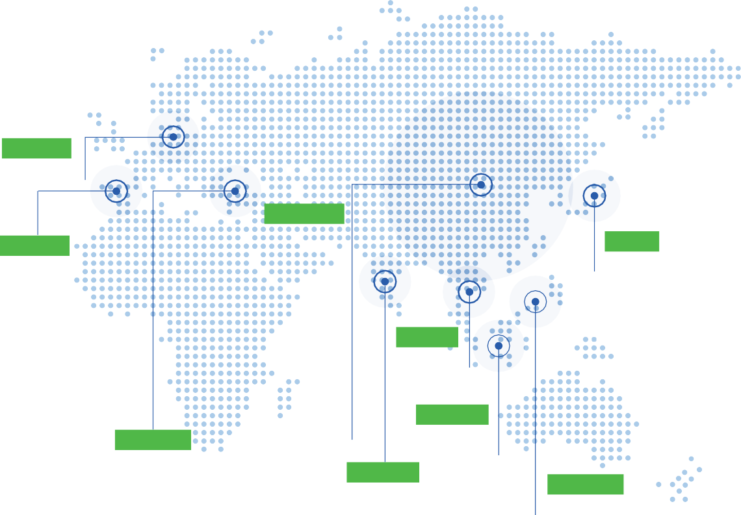
Making clean energy fer, more stable and accessible
COMPANY DEVELOPMENT
Germany
The EU Oﬃce
China
Great Power Headquarters
Quzhou GP Henan GP Zhuhai GP Liuzhou GP Changzhou GP Shida Battery Co., Ltd.
Spain
The Spain Oﬃce
Japan
The Japanese Oﬃce
United States
The NA Oﬃce
Vietnam
Vietnam GP
Chile
The Chile Oﬃce
Qingdao GP
Singapore
Turkey
The Sing_{O}ap_{ﬃ}o_{c}r_{e}
The Turkey SPV
India
Indonesia
The Indonesia Oﬃce
(Un^{T}d^{h}er^{In}C^{d}o^{i}nªs^{O}tr^{ﬃ}uc^{c}t^{e}ion)
COMPANY MILESTONES
²⁰⁰² ·^{Z}N^{h}a^{u}ti^{h}oªn^{i}a^{G}l Po^{w}sªt-^{s}d^{f}oºc^{u}t^{n}o^{d}ra^{e}l^{d}
₂₀₁₃ Henan GP was founded
_{2018 ·}C_{Ac}h_{q}a_{u}n_{i}g_{r}z_{e}h_{d}o_{S}u_{H}G_{ID}P_{A}w_{B}a_{a}s_{tt}fo_{er}u_{y}nded
^{2021 H}st^{e}a^{n}rtªe^{n}d^{G}m^{P} a^{II}ss
_{2023 · T}Q_{h}in_{e}g_{E}d_{U}ao_{O}G_{ﬃ}P_{ce}w_{an}s _{d}founded
₂₀₂₅ P_{of}la_{o}n_{v}n_{e}e_{r}d₁₁p₀r_{G}od_{W}u_{h}c.t_{T}io_{o}n_{b}c_{e}a_{c}p_{o}a_{m}ci_{e}ty_{a}
Technological Center
production
the NA Oﬃce were founded
global leader (in supplying ) of
founded
energy storage battery
^{2001 G}w^{r}a^{e}sªf^{t}o^{P}uºn^{w}ded
^{2011 F}e^{i}n^{r}e^{st}r⁻g^{g}y^{e}s^{n}t^{e}o^{r}rªa^{t}g^{io}e^{n}battery
²⁰¹⁵ ·^{W}Ac^{e}q^{n}u^{t}ir^{p}e^{u}d^{b}N^{lic}ex⁽c^{IP}e^{O}ll ⁾
^{2019 L}w^{i}a^{u}s^{zh}foºu^{u}n^{G}d^{P}ed
^{2022 Q}w^{u}as^{zh}foun^{G}d^{P}ed
²⁰²⁴ · S^{Es}e^{t}tªu^{b}p^{lis}o^{h}ﬃ^{e}c^{d}e^{V}s^{i}i^{e}n^{tn}Inªd^{m}o^{G}ne^{P}sia, Singapore,
was launched
(Japan)
Chile and Spain
03
04

Slide 4
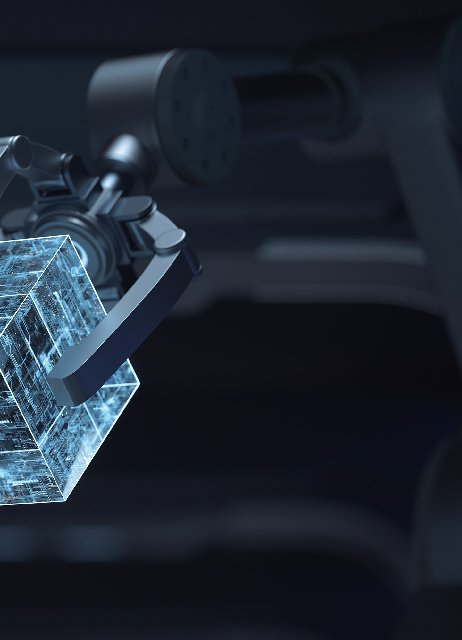
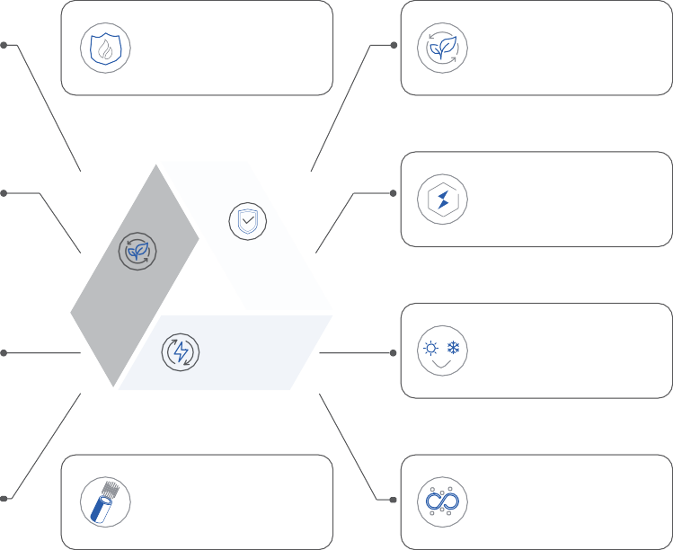
Making clean energy fer,
more stable and accessible
R&D STRENGTH
TECHNOLOGY MILESTONES
Great Power have pa_{o}r_{f}ti_{b}c_{a}ip_{tt}a_{e}t_{r}e_{y}d_{in}in_{d}t_{u}h_{s}e_{tr}d_{y}r_{s}a_{t}f_{a}ti_{n}n_{d}g_{a}o_{rd}f _{s}a _{i}n_{n}u_{C}m_{h}b_{in}e_{a}r
E²n²gi⁰ne⁰er⁺s
R⁴esearch Institutes
Na⁺ Battery
Ener_{S}g_{y}y_{s}S_{te}to_{m}rage
Secondary
2024
Battery
P_{B}r_{a}im_{tte}a_{r}r_{y}y
P²rovincial-level
N¹ational-level Postdoctoral
2023
La^{L}rªg^{u}e^{n}C^{c}y^{h}l^{e}in^{d}d^{t}r^{h}ic^{e}a^{H}l B^{O}a^{M}tt^{E}e⁻r^{II}ie^{S}s^{e}, ^{r}t^{i}h^{e}e^{s}
Research Centers
Research Center
R^{P}e^{r}sºe^{d}a^{u}rch
Re^{B}sªe^{s}a^{i}r^{c}ch
T_{m}h_{a}e_{ss}pr_{p}o_{r}d_{o}u_{d}c_{u}t_{c}s_{t}w_{io}i_{n}th_{.M}S_{a}2_{s}4_{s} t_{p}e_{r}c_{o}h_{d}n_{u}o_{c}l_{t}o_{io}g_{n}y s_{o}t_{f}art
^{P}R^{O}e^{L}si^{A}d^{R}en^{S}t^{e}i^{r}a^{i}l^{e}E^{s}n^{L}eºr^{w}gy^{-T}S^{e}t^{m}or^{p}a^{e}g^{r}eª,^{t}t^{u}h^{r}e
Sectors
Sectors
M^{B} at^{t}e^{e}r^{r}ia^{y}l
590_{a}U_{n}l_{d}tra_{th}E_{e}n_{ﬁ}e_{r}r_{s}g_{t}y_{g}S_{e}t_{n}o_{e}ra_{ra}g_{t}e_{io}C_{n}e_{o}ll_{f},
An^{A}d^{na}T^{l}e^{y}st^{is}ing
s_{com}iu_{m}m_{e}-_{r}i_{c}o_{ia}n_{li}b_{zat}t_{io}er_{n}ie_{s}s_{ta}h_{g}a_{e}s. entered the
Solid-State Battery.
4
P¹r⁰es⁺tigious partners of universities/
Optimization
Cell
New
2022
Testing Center
i_{e}n_{le}st_{c}i_{tr}u_{o}t_{c}io_{h}n_{e}s_{m}in_{istr}h_{y}e ﬁeld of
Structure
Battery
2021
The sodium-ion batteries started small
batch produc on. The large cylindrical
The company started producing
batteries with full-ear electrodes and
product from recycling of waste
long-life technology are launched.
batteries.
2019
The EV batteries with 6C
2018
KEY TECHNOLOGY
High-safety LFP Battery
T_{aq}h_{u}e_{e}b_{o}a_{u}tt_{s}e_{m}rie_{a}s_{te}w_{ria}th_{l m}a _{o}te_{v}r_{e}n_{d}ar_{in}y_{t}h_{o}ig_{m}h_{a}-n_{ss}ickel
fast-charging was launched.
production.
2011
First-generation energy storage
^{F}Ele^{m}ctr^{e}o^{-r}ly^{e}t^{t}e^{ar}T^{d}eªc^{n}h^{t}n^{G}o^{e}lo^{l} gy
Long Cycle Life Battery
²Th⁰e c⁰om⁹pany participated in the drafting of
v
industry standards such as General
battery, 10/20Ah LFP , was launched
Requirements for Lithium Iron Phosphate Battery Modules and Ge ar l Require
ments for Lithium Manganese Dioxide Battery Modules
All-Solid-State Battery
High-power UPS Battery
2006
Technology
The polymer battery and its
Long Cycle
S^{H}a^{i}f^{g}e^{h}ty
H_{Eﬃ}ig_{c}h_{ie}E_{nc}e_{y}rgy
2004
^{m}goªl^{n}d^{u}a^{fa}w^{c}a^{t}r^{u}d^{ri}a^{n}t^{g}t^{m}he^{e}1th6ºth^{d}N^{w}aºt^{n}io^{t}n^{h}a^{e}l
Sodium ion Battery
Life
LFP Ultra-wide
Invention Exhibition
I_{T}n_{e}d_{c}u_{h}s_{n}t_{o}ri_{l}a_{o}l_{g}iz_{y}ation
_{Te}m_{ch}p_{n}e_{o}r_{l}a_{o}t_{g}u_{y}re Range
^{G}H^{r}ig^{e}hª-^{t}e^{P}ﬃºc^{w}ien^{r} cy Battery
^{T}su^{h}c^{e}c^{l}e^{it}s^{h}s^{i}fully^{i}l^{r}aºu^{n}n^{b}cªh^{t}e^{te}d^{r},^{y}ﬁ⁽ll^{L}in^{i-}g^{Fe}t^{S}h²e^{) w}inªd^{s}ustrial
^{g}Mªe^{p}dium^{Ch}E^{i}nteªrp^{n}r^{d}is^{w}es^{in}Inn^{n}o^{g}v^{t}a^{h}t^{e}ion^{Sm}Aw^{al}a^{l}rªd^{n}.^{d}
2003 ^{v}
^{Th}p^{e}o^{t}l^{e}ym^{ch}e^{n}rºa^{l}nºd^{gy}liºg^{f}h^{L}tw^{ith}eigh^{m}t
^{L}Sºu^{w}pe^{-t}r^{e}c^{m}on^{p}d^{e}u^{ra}cti^{u}n^{r}g^{e} LTSC
L_{T}a_{e}r_{c}g_{h}e_{n}C_{o}y_{lo}li_{g}n_{y}der with Lug
²Ni-⁰MH⁰18¹00mAh battery approved to be
battery got invention patent.
Technology
Technology
International Advanced Level.
05
06

Slide 5
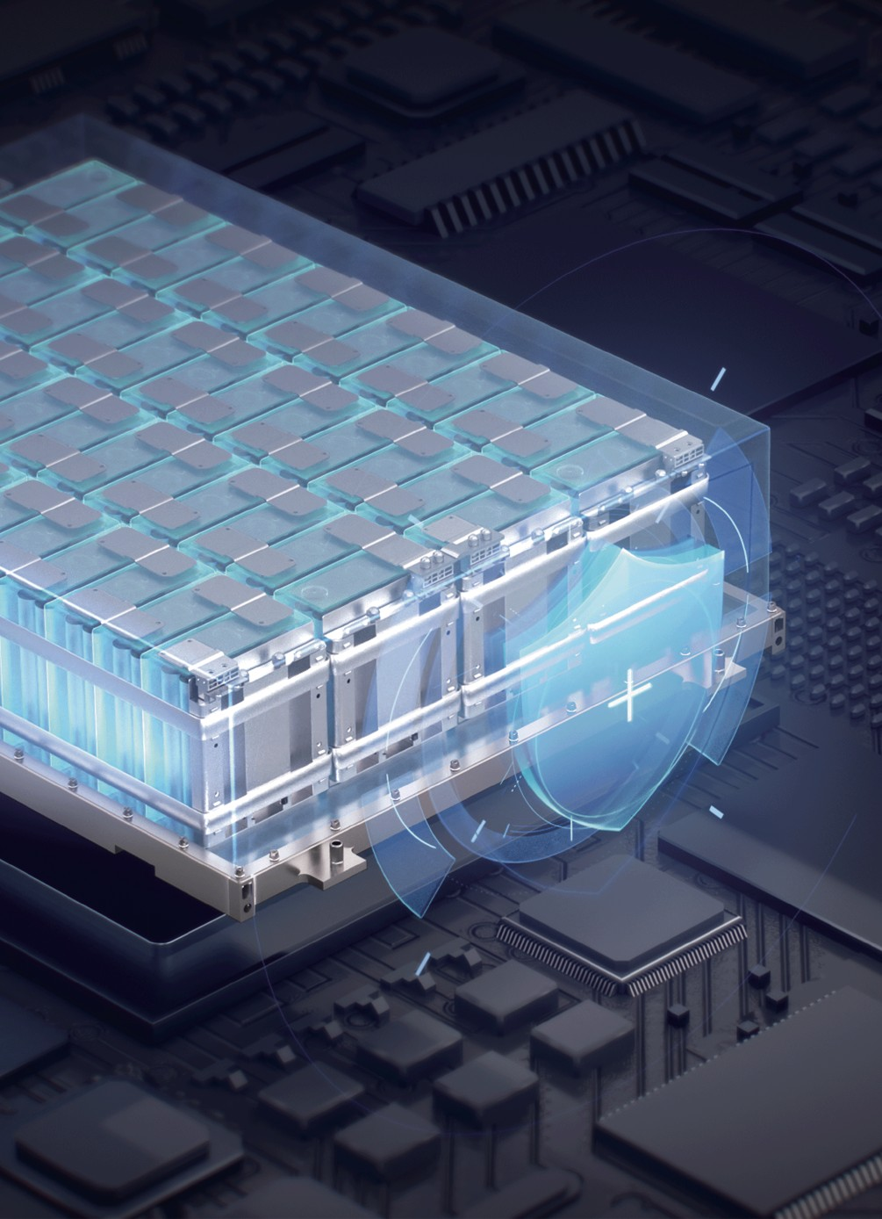
Making clean energy fer, more stable and accessible
QUALITY ASSURANCE
Quality Management System: ISO9001, ISO14001, IATF16949
Success comes from strict quality management and unwavering attention to detail. All manufacturing facilities have certiﬁcation of ISO9001, ISO14001, IATF16949, GJB9001B and ISO45001:2018, guaranteeing a strict quality management system that adds customer value. All ESS batteries are certiﬁed by UL, RoHS, CE, and QCT-743-2006.
^{P}Ou^{r}rºq^{f}u^{e}al^{s}ity^{s}a^{io}ss^{n}urªan^{l}c^{T}e t^{e}eªam^{m}consists of international top-tier electrochemical experts and battery
process quality control specialists with over 20 years of experience. We are committed to delivering high-quality battery products and services, aiming to create higher value for our customers.
Full-process Inspection
Our quality inspection process covers every stage of R&D and manufacturing, including raw material checks, production monitoring, lab testing, and ﬁnal factory inspection. On average, each battery undergoes over 100 testing items to ensure exceptional performance and quality.
Worldwide Testing and Qualiﬁcations
IEC62619
UL1973
UL9540A
UL1642
P^{T}P^{U}P^{V}59^{S}0^{U}4^{D}4A
NFPA 855
Japan JET
MSDS
RoHS
UN38.3
GB/T36276
EMC, LVD
07
08

Slide 6
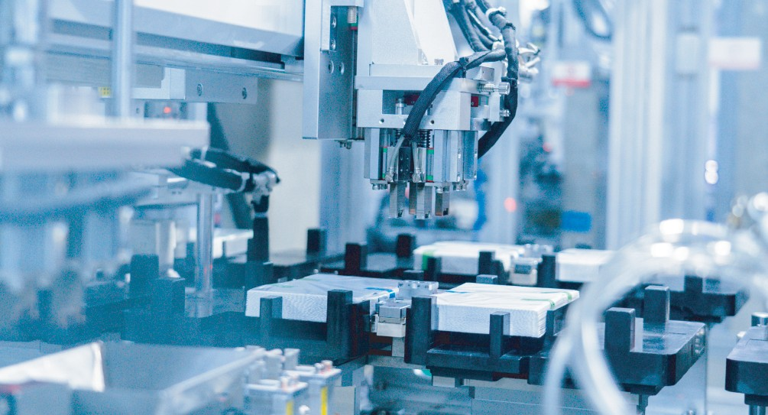
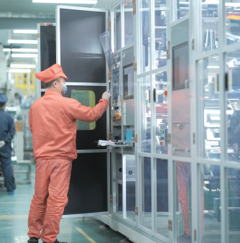
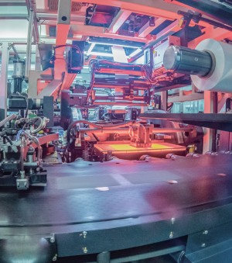
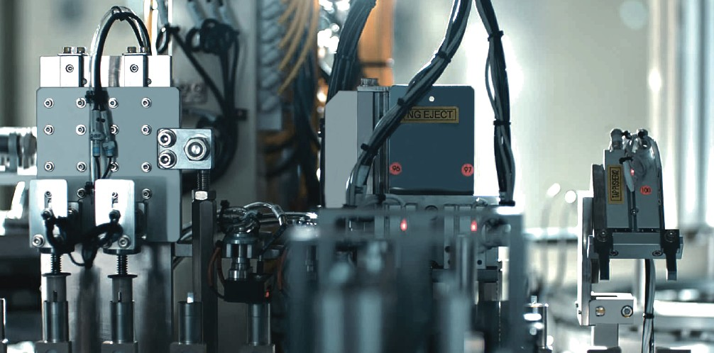
^{M}mªo^{k}re^{in}s^{g}ta^{c}b^{le}lªe^{n}an^{en}d^{e}a^{r}c^{g}c^{y}essi^{f}b^{e}l^{r}e,
13
GLOBAL ADVANCED AUTOMATED PRODUCTION
State of the Art Factories
· Imported globally advanced production lines
· Full coverage of FFU manufacturing environment
· Class 6 manufacturing environment
· Industry leading quality driven by continuous process improvement
· 24-hour monitoring and control of key production processes
Key Processes
Stacking: adopting the industry-leading Z-shaped femtosecond stacking technology, it perfectly
solves the eﬃciency of disc stacking and overhang control.
Winding: using the globally leading winding equipment, multi-stage tension variation and real-time
correction technology, it perfectly solves the deformation and alignment of winding batteries.
High Consistency
Utilizing high-precision fully automatic production equipment, comprehensive MES system coverage
throughout the entire process, real-time monitoring of equipment parameters and product processes
with a big data warning system, fully automated closed-loop correction, achieving high consistency in
battery cell products, with multiple data indicators reaching a 6 Sigma.
High-precision Fully Automatic Spiral Rod Mixing Technology
Capacity-separated Liquid Cooling Technology
09
10

Slide 7
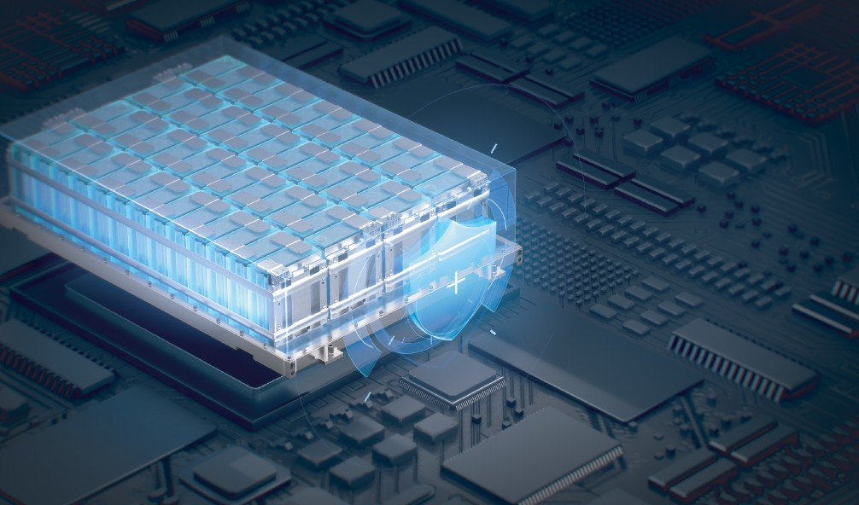
^{M}mªo^{k}re^{in}s^{g}ta^{c}b^{le}lªe^{n}an^{en}d^{e}a^{r}c^{g}c^{y}essi^{f}b^{e}l^{r}e,
ACHIEVEMENTS
KEY CUSTOMERS
^{T}202^{O}3 C^{P}hine³se Commercial and Industrial ESS Market (GGII)
^{T}202^{O}3 G^{P}lob³al Residential ESS Battery Market (EESA) ^{T}202^{O}3 G^{P}loba⁶l Power EESA Battery Market among Chinese Companies (EESA) ^{T}202^{O}3 G^{P}loba⁶l ESS Battery Market among Chinese Companies(SNE Research) ^{B}202^{N}4 B^{E}NE^{F}F Ti^{T}er ^{i}1eEn^{r}er¹gy Storage Manufacturer (BloombergNEF)
TOP2 in 2021 Global ESS Battery Market(CNESA) TOP4 in 2021 for Newly Commissioned Installed Capacity in China (CNESA)
2022 EV Group Standard Drafting Unit (Guangdong Energy Association) TOP2 in 2022 Global Residential ESS Battery Market (GGII, ICC, EESA, SPIR) TOP5 in 2022 Global ESS Battery Market(CNESA, GGII, EESA)
2023 First Batch of Units Passing National Sodium-ion Battery Evaluation in China (SEI Laboratory/CNESA) 2023 TOP 10 Innovative Enterprises in Sodium-ion Batteries (CNESA) 2023 TOP 500 Global New Energy Companies (China Energy News) 2023 Global Financeable Battery Industry List (BNEF)
2024 8th International Energy Storage Innovation Competition - Outstanding Project Award (320 Ultra Cell) (CNESA) 2024 Carbon Neutral Technology Innovation Exemplary Case (China Energy News) 2024 Top 500 Global New Energy Companies (China Energy News)
11
12

Slide 8
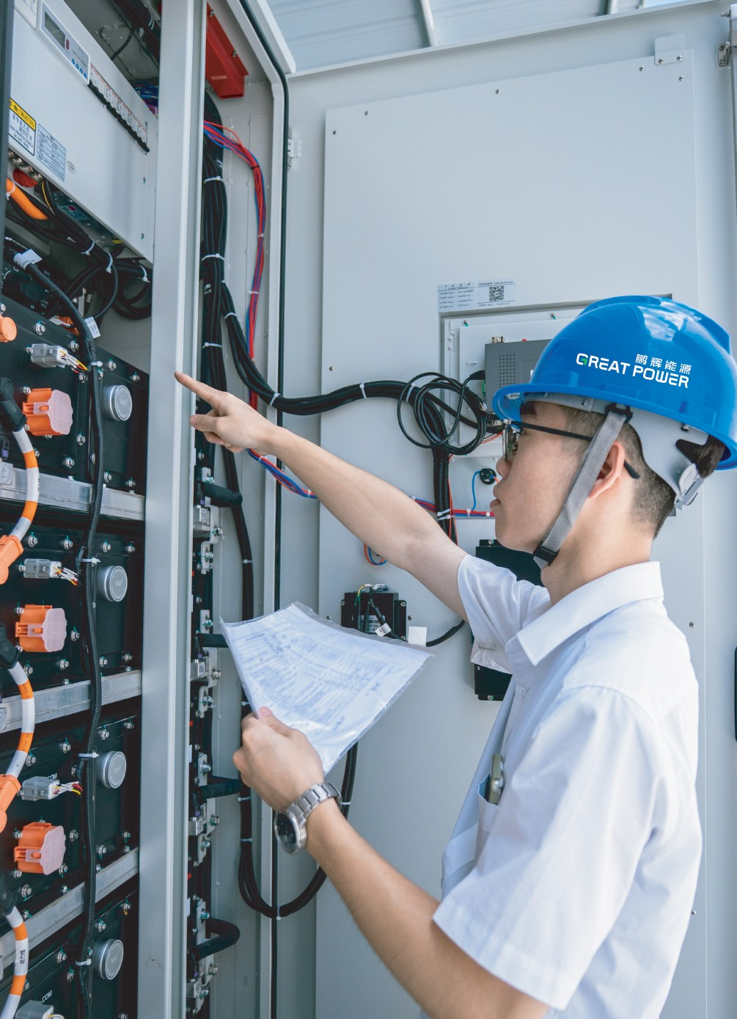
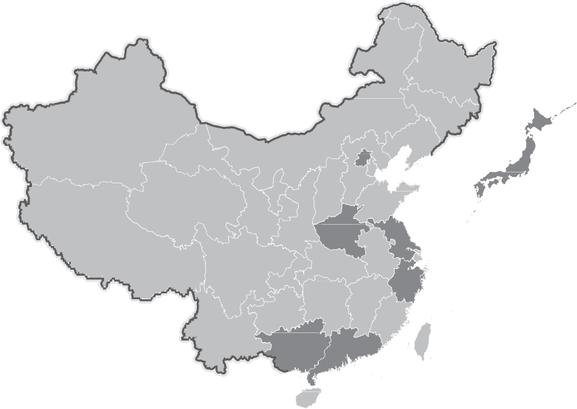
^{M}mªo^{k}re^{in}s^{g}ta^{c}b^{le}lªe^{n}an^{en}d^{e}a^{r}c^{g}c^{y}essi^{f}b^{e}l^{r}e,
SERVICE AND SUPPORT
Service Team: 15 professional teams distributed in nine regions. Complaint Feedback: Feedback within 24 hours, temporary solutions provided within 48 hours, overall solutions provided within 5 working days.
VIP Service: On-site support at the factory. System Service: Free regular inspections during the warranty period with various service methods.
15 professional teams in 9 regions
Henan service center
Beijing service center
Changzhou service center
Japan service center
9
4
3
5
8
Quzhou Service Center
Guangzhou headquarters service
Liuzhou Service Center
6
₇ 1
command center
Zhuhai Service Center
2
Foshan service center
13
14

Slide 9
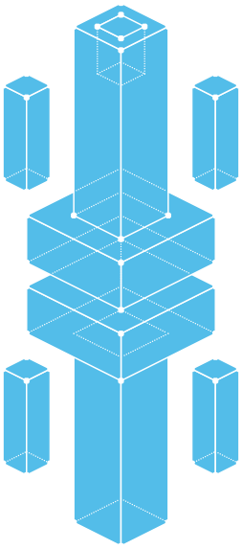
PRODUCTS AND SOLUTIONS
PRODUCT MATRIX
Utility-scale Energy Storage Batteries
Resi₍d_{In}e_{c}n_{l}t_{u}ia_{d}l_{in}E_{g}ne_{P}r_{O}gy_{LA}S_{R}to_{S}r_{e}a_{r}g_{ies}C₎ells
Cells
Large Cylindrical Batteries
01
Battery
Sodium-ion Batteries
Energy Storage
Packs
Liqu_{P}id_{a}-_{c}c_{k}o_{s}oled
Air_{P}-c_{a}o_{c}o_{ks}led
Liqu_{R}id_{a}-_{c}c_{k}o_{s}oled Air_{R}-c_{a}o_{c}o_{ks}led
Cu_{P}s_{ro}to_{d}m_{uc}iz_{t}e_{s}d
Cu_{P}s_{ro}to_{d}m_{uc}iz_{t}e_{s}d Cu_{P}s_{ro}to_{d}m_{uc}iz_{t}e_{s}d Cu_{P}s_{ro}to_{d}m_{uc}iz_{t}e_{s}d
Batteries
Racks
Magna-C&I-215
Magna-C&I-260 Magna-UTL-373 Magna-UTL-418 Max-20HC-3440 Max-20HC-5000
Outd_{S}o_{y}o_{s}r_{te}B_{m}attery
C_{S}u_{o}st_{lu}o_{t}m_{io}iz_{n}e_{s}d
Product Solution
02
^{C}Sºto^{n}r^{t}ag^{in}e^{e}S^{r}o^{E}l^{n}u^{e}ti^{r}o^{g}n^{y}
15
16

Slide 10
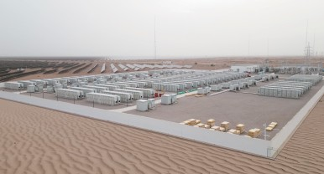
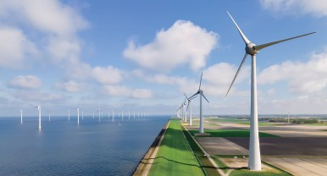
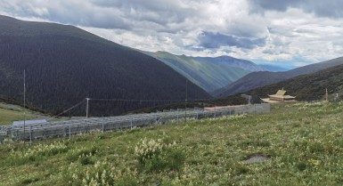
^{M}mªo^{k}re^{in}s^{g}ta^{c}b^{le}lªe^{n}an^{en}d^{e}a^{r}c^{g}c^{y}essi^{f}b^{e}l^{r}e,
APPLICATIONS OF ENERGY STORAGE SYSTEMS
Great Power's energy storage products are widely applied in utility-scale, residential, commercial and industrial sectors.
Utility Scale Energy Storage
Peak shaving: charge when the load is low and discharge when the load is high.
Renewable Integration: renewable energy generation is characterized by its randomness, intermittency and ﬂuctuation. Energy storage regulates the output to meet grid connection requirements.
Utility Scale Energy Storage
Energy arbitrage: store the electrical energy from the wind and photovoltaic energy generation plants at high peaks and
deliver the energy to the grid at other periods to improve the energy utilization eﬃciency.
System frequency control: responsive within milli seconds and able to reduce the impact of change in load on the grid, thus
improve the stability of the grid.
Alleviate Congestion: alleviate the conﬂicts of power consumption at high peaks and enhance the utilization of circuit for power transmission to relieve the necessity of grid system upgrade.
Backup power supply: ensure safe and stable power supply when there is a power failure.
Commercial & Industrial Energy Storage (C&I)
Energy arbitrage: charge when the electricity price is low and discharge when the price is high to achieve price diﬀerence
Residential
Commercial & Industrial
arbitrage, thus reduce the cost of electricity usage.
Energy Storage
Energy Storage (C&I)
Dynamic capacity expansion: reduce the overall load of grid with increased capacity and decreased cost if industrial users
can store energy during the periods of low load and discharge the energy during the periods of high load.
Backup power supply: act as an emergency energy source and ensure uninterrupted power supply for key instruments.
Residential Energy Storage
Energy arbitrage: charge when the electricity price is low/and discharge when the price is high to achieve price diﬀerence arbitrage, thus reduce the electricity cost.
Oﬀ-grid operation: ensure the power supply in remote regions by integrating the system with photovoltaic generation systems.
Portable energy source: suitable for indoor and outdoor activities as well as emergency situations where there is no access to the grid electricity.
Desert Gobi
Marine Climate
Tropical Environment
Plateau Environment
17
18

Slide 11
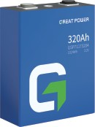
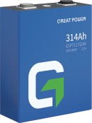
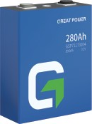
CELLS
Making clean energy fer,
more stable and accessible
ENERGY STORAGE CELLS
320Ah
High Safety
Product model
GSP71173204F
320 Ah
0.5 P
≥8000@70% LFP
0~60℃
-30~60℃
Utility-scale, C&I
Global safety certiﬁcations: UL, IEC, UN, MSDS, RoHS, GB
Non-ﬂammable and non-explosive design Guaranteeing safety in energy storage systems
Long Cycle Life
Over 8,000 cycles for long-lasting use
25-year lifespan under standard operating conditions Cost reduction, eﬃciency enhancement, economic gain
High Energy Eﬃciency
The energy eﬃciency ≥ 96.0% Customer value maximization
Capacity
Charging/Discharging rate
Cycle life
Chemistry
Charging Temperature
Discharging Temperature
Applications
^{T}Certi^{n}ﬁ^{g}c&ations
GB/T36276
UL1973 UL9540A IEC62619 RoHS Reach
UN38.3
314Ah
Product model GSP71173204F
Capacity 314 Ah
Charging/Discharging rate 0.5 P
Cycle life ≥8000@70%
Chemistry LFP
Charging Temperature 0~60℃
Discharging Temperature -30~60℃
Applications Utility-scale, C&I
^{T}Certi^{n}ﬁ^{g}c&ations
GB/T36276
UL1973 UL9540A IEC62619 RoHS Reach
UN38.3
280Ah
Product model GSP71173204F
Capacity 280 Ah
Charging/Discharging rate 0.5 P
Cycle life ≥6000@80%
Chemistry LFP
Charging Temperature 0~60℃
Discharging Temperature -30~60℃
Applications Utility-scale, C&I
^{T}Certi^{n}ﬁ^{g}c&ations
GB/T36276 UL1973 UL9540A UL1642 IEC62619 MSDS RoHS
UN38.3
19
20

Slide 12
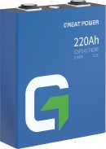
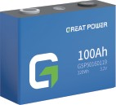
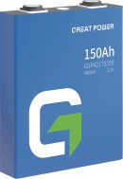
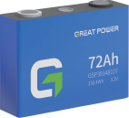
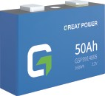
CELLS
Making clean energy fer,
more stable and accessible
CELLS
220Ah
100Ah
Product model
GSP54174206F
Product model
GSP50160119F
Capacity
220 Ah
Capacity
100 Ah
Charging/Discharging rate
0.5 C
Charging/Discharging rate
1 C
Cycle life
≥6000@70%
Cycle life
≥4000＠80％
Chemistry
LFP
Chemistry
LFP
Charging Temperature
0~60℃
Charging Temperature
0~60℃
Discharging Temperature
-30~60℃
Discharging Temperature
-30~60℃
Residential, Portable
Applications
Utility-scale, C&I
Applications
^{T}Certi^{n}ﬁ^{g}c&ations
GB/T36276 MSDS RoHS
UN38.3
^{T}Certi^{n}ﬁ^{g}c&ations
IEC62619 UL1973
MSDS
UN38.3 Japan JET
150Ah
72Ah
Product model
GSP42173205F
Product model
GSP39148107F
Capacity
150 Ah
Capacity
72 Ah
Charging/Discharging rate
1 C
Charging/Discharging rate
1 C
Cycle life
≥4000@80%
Cycle life
≥4000@80%
Chemistry
LFP
Chemistry
LFP
Charging Temperature
0~60℃
Charging Temperature
0~60℃
Discharging Temperature
-30~60℃
Discharging Temperature
-30~60℃
Applications
Utility-scale, C&I
Applications
Residential, Portable
^{T}Certi^{n}ﬁ^{g}c&ations
IEC62619 GB/T36276 UL1973
BIS
UN38.3
50Ah
Product model
GSP3914895F
Capacity
50 Ah
Charging/Discharging rate
1 C
Cycle life
≥4000@80%
Chemistry
LFP
Charging Temperature
0~60℃
Discharging Temperature
-30~55℃
Residential, Portable
Applications
^{T}Certi^{n}ﬁ^{g}c&ations
MSDS
UN38.3
21
22

Slide 13
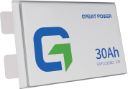
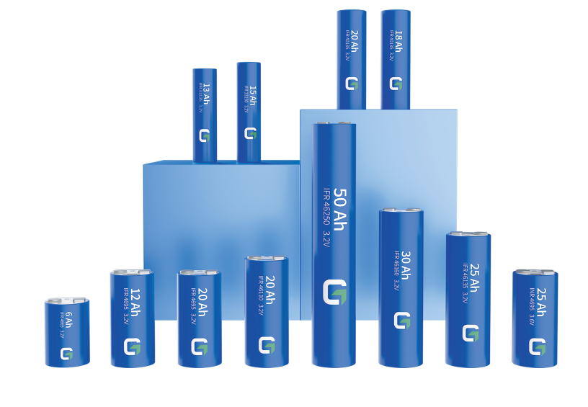
CELLS
^{M}mªo^{k}re^{in}s^{g}ta^{c}b^{le}lªe^{n}an^{en}d^{e}a^{r}c^{g}c^{y}essi^{f}b^{e}l^{r}e,
HOME SERIES
Large Cylindrical Battery
37Ah
Product model GSP11141238
^{C}ba^{u}t^{r}t^{r}e^{e}r^{n}ie^{tl}s^{y}.,T^{G}h^{r}e^{e}sªe^{t} b^{P}aºt^{w}te^{e}r^{r}ie^{h}sªh^{s}a^{s}v^{h}e^{ip}b^{p}e^{e}e^{d}n ^{m}thºro^{re}ug^{t}h m^{n} a⁵r⁰ke^{m}t ^{i}p^{ll}r^{i}ov^{n}e^{u}n^{n}, ^{i}s^{t}h^{s}oºw^{f} c^{t}a^{h}s^{e}in^{H}g^{O}e^{M}xc^{E}e^{s}ll^{e}e^{r}n^{ie}t ^{s}p^{l}eªr^{r}f^{g}o^{e}rm^{c}a^{yl}n^{in}ce^{dr}a^{ic}nªd^{l}
Capacity 37 Ah
Charging/Discharging rate 1 C
Cycle life ≥6000@80%
Chemistry LFP
Charging Temperature 0~55℃
Discharging Temperature -15~55℃
Applications Residential, Portable
gaining widespread customer approval and positive feedback. This series has become one of Great
Power's top-selling products.
W_{se}e_{rie}la_{s}u, n_{w}c_{it}h_{h}e_{b}d_{a}H_{tt}O_{e}M_{ry}E_{ca}-Ⅱ_{pa}s_{c}e_{it}r_{i}i_{e}e_{s}s _{r}i_{a}n_{n}2_{g}0_{in}2_{g}4,_{fr}a_{o}n_{m}d t₆h_{A}e_{h}p_{to}ro₅d₀u_{A}c_{h}t.matrix includes the 33 series, 40 series, and 46
The HOME series incorporates various battery technologies. Great Power's independently developed
t_{h}w_{a}o_{ve}a_{s}n_{u}ti_{c}-_{c}e_{e}x_{s}p_{s}lo_{fu}s_{l}i_{l}o_{y}n_{p}p_{a}r_{s}e_{s}s_{e}s_{d}u_{t}r_{h}e_{e}r_{r}e_{m}lie_{a}f_{l} v_{r}a_{u}l_{n}v_{a}e_{w}s p_{ay}ro_{a}v_{n}id_{d}e_{p}s_{u}th_{n}e_{ct}b_{u}a_{re}tte_{te}ri_{s}e_{ts,}w_{e}i_{n}th_{su}e_{r}x_{in}ce_{g}p_{m}ti_{a}o_{x}n_{i}a_{m}l _{u}sh_{m}oc_{sa}k_{f}r_{e}e_{t}s_{y}is_{fo}ta_{r}n_{u}c_{s}e_{e}._{r}T_{s.}h_{B}e_{y}
adhering to ﬁrst-principle and fully leveraging the advantages of the cylindrical s uctu e, th structural components have been highly integrated. This signiﬁcantly shortens the electron transfer distance
30Ah
a_{te}n_{m}d_{p}h_{e}e_{r}a_{a}t_{tu}d_{r}i_{e}ss_{r}i_{i}p_{se}at_{u}io_{n}n_{de}d_{r}is_{h}t_{i}a_{g}n_{h}c_{r}e_{a},_{t}g_{e}r_{s}e, a_{a}t_{ll w}e_{h}n_{il}h_{e}a_{s}n_{u}c_{b}in_{st}g_{a}t_{n}h_{t}e_{ia}b_{lly}at_{l}t_{o}e_{w}ry_{e}'_{r}s_{in}h_{g}ig_{c}h_{o}-_{s}p_{t}o_{s}w. er performance and reducing
^{I}c^{n}yl^{t}in^{e}d^{rm}ric^{s}aºl ^{f}b^{c}a^{y}tt^{c}e^{le}rie^{l}s^{if},^{e}s, o^{w}lv^{e}in^{h}gªt^{v}h^{e}e^{d}f^{e}a^{v}s^{e}t-^{l}cºh^{p}a^{e}r^{d}ginªg^{u}c^{n}y^{i}c^{q}l^{u}e^{e}d^{c}is^{y}c^{c}r^{l}e^{ic}pa^{s}n^{tr}c^{e}y^{ss}issu^{el}e^{f}.^{-r}A^{e}d^{li}d^{e}i^{v}t^{i}i^{n}o^{g}na^{t}l^{e}ly^{c},^{h}t^{n}wºo^{lo}k^{g}e^{y}y ^{f}iºn^{r}d^{l}uªs^{r}t^{g}r^{e}y
Product model GSP11133202
Capacity 30 Ah
Charging/Discharging rate 0.5 C
Cycle life ≥6000@80%
Chemistry LFP
Charging Temperature 0~55℃
Discharging Temperature -15~55℃
Applications Residential, Portable
^{c}te^{h}aªmlles^{n}. A^{g}s^{es}a ªre^{b}sºu^{u}lt, ^{b}thªe^{tt}H^{er}O^{y}M^{li}E^{fe}s,e^{e}r^{l}ies^{t}b^{r} oa^{y}s^{t}t^{e}s ^{l}a^{ea}c^{k}yªcl^{g}e^{e}liªfe^{nd}of^{b}oªv^{t}e^{t}r^{er}5^{y},0e0^{x}0^{p}cªy^{n}c^{s}le^{io}s^{n}, e, nªs^{re}urºin^{v}g^{er}m^{co}o^{m}re^{e}th^{b}a^{y}n º1^{u}0^{r}y^{R}ea&r^{D}s
of high-frequency usage for customers.
^{T}Certi^{n}ﬁ^{g}c&ations
IEC62619
BIS
UN38.3
25Ah
Product model GSP82141238
Capacity 25 Ah
Charging/Discharging rate 0.5 C
Cycle life ≥6000@80%
Chemistry LFP
Charging Temperature 0~55℃
Discharging Temperature -15~55℃
Applications Residential, Portable
T ng&
Certiﬁcations
IEC62619 UL1973 MSDS
UN38.3
23
24

Slide 14
^{M}mªo^{k}re^{in}s^{g}ta^{c}b^{le}lªe^{n}an^{en}d^{e}a^{r}c^{g}c^{y}essi^{f}b^{e}l^{r}e,
46 Series
50Ah
30Ah
Product model
INR 46190
Product model
IFR 46160
Capacity
50 Ah
Capacity
30 Ah
Charging rate
1.0 C
Charging rate
1.2 C
Discharging rate
2.0 C
Discharging rate
3.0 C
1C Cycle life
≥2000
1C Cycle life
≥3000
0.5C Cycle life
≥3000
0.5C Cycle life
≥6000
Chemistry
NCM
Chemistry
LFP
Charging Temperature
-10~55℃
Charging Temperature
-20~55℃
Discharging Temperature
-20~60℃
Discharging Temperature -20~60℃
Applications
Two wheelers, electric motorcycles
Applications
Portable energy storage, residential energy
storage，two wheelers, electric motorcycles
25Ah
25Ah
Product model
INR 46100
Product model
IFR 46135
Capacity
25 Ah
Capacity
25 Ah
Charging rate
1.0 C
Charging rate
1.2 C
Discharging rate
3.0 C
Discharging rate
3.0 C
1C Cycle life
≥2000
1C Cycle life
≥3000
0.5C Cycle life
≥3000
0.5C Cycle life
≥6000
Chemistry
NCM
Chemistry
LFP
Charging Temperature
-10~55℃
Charging Temperature
-20~55℃
Discharging Temperature
-20~60℃
Discharging Temperature -20~60℃
Applications
Two wheelers, electric motorcycles
Applications
P_{st}o_{o}r_{r}t_{a}a_{g}b_{e}l，e_{t}e_{w}n_{o}er_{w}g_{h}y_{e}s_{e}to_{le}r_{r}a_{s}g, e_{e},_{le}re_{c}s_{tr}id_{ic}e_{m}nt_{o}ia_{t}l_{o}e_{rc}n_{y}e_{c}r_{l}g_{e}y_{s}
50Ah
20Ah
Product model
IFR 46250
Product model
IFR 46110
Capacity
50 Ah
Capacity
20 Ah
Charging rate
1.2 C
Charging rate
1.2 C
Discharging rate
2.0 C
Discharging rate
3.0 C
1C Cycle life
≥3000
1C Cycle life
≥3000
0.5C Cycle life
≥6000
0.5C Cycle life
≥6000
Chemistry
LFP
Chemistry
LFP
Charging Temperature
-20~55℃
Charging Temperature
-20~55℃
Discharging Temperature -20~60℃
Discharging Temperature -20~60℃
Applications
Portable energy storage, residential energy
Applications
Portable energy storage, residential energy
storage，two wheelers, electric motorcycles
storage，two wheelers, electric motorcycles
25
26

Slide 15
^{M}mªo^{k}re^{in}s^{g}ta^{c}b^{le}lªe^{n}an^{en}d^{e}a^{r}c^{g}c^{y}essi^{f}b^{e}l^{r}e,
12Ah
18Ah
Product model
IFR 4695
Product model
IFR 40135
Capacity
12 Ah
Capacity
18 Ah
Charging rate
20 C
Charging rate
2.0 C
Discharging rate
20 C
Discharging rate
3.0 C
1C Cycle life
≥10000
1C Cycle life
≥3000
0.5C Cycle life
≥20000
0.5C Cycle life
≥6000
Chemistry
LFP
Chemistry
LFP
Charging Temperature
-30~55℃
Charging Temperature
-20~55℃
Discharging Temperature
-40~60℃
Discharging Temperature
Applications
-20~60℃
Applications
12V jump starter
P_{st}o_{o}r_{r}t_{a}a_{g}b_{e}l，e_{t}e_{w}n_{o}er_{w}g_{h}y_{e}s_{e}to_{le}r_{r}a_{s}g, e_{e},_{le}re_{c}s_{tr}id_{ic}e_{m}nt_{o}ia_{t}l_{o}e_{rc}n_{y}e_{c}r_{l}g_{e}y_{s}
6Ah
33 Series
Product model
IFR 4665
15Ah
Capacity
6 Ah
Charging rate
20 C
Product model
IFR 33150
Discharging rate
40 C
Capacity
15 Ah
1C Cycle life
≥10000
Charging rate
1.2 C
0.5C Cycle life
≥20000
Discharging rate
3.0 C
Chemistry
LFP
1C Cycle life
≥3000
Charging Temperature
-30~55℃
0.5C Cycle life
≥6000
Discharging Temperature
-40~60℃
Chemistry
LFP
Applications
H₄₈y_{V}br_{ju}id_{m}e_{p}le_{s}c_{t}t_{a}r_{r}ic_{te}v_{r}ehicle
Charging Temperature
-20~55℃
Discharging Temperature
Applications
-20~60℃
40 Series
P_{st}o_{o}r_{r}t_{a}a_{g}b_{e}l，e_{t}e_{w}n_{o}er_{w}g_{h}y_{e}s_{e}to_{le}r_{r}a_{s}g, e_{e},_{le}re_{c}s_{tr}id_{ic}e_{m}nt_{o}ia_{t}l_{o}e_{rc}n_{y}e_{c}r_{l}g_{e}y_{s}
20Ah
13Ah
Product model
IFR 40135
Product model
IFR 33135
Capacity
20 Ah
Capacity
13 Ah
Charging rate
1.2 C
Charging rate
1.2 C
Discharging rate
3.0 C
Discharging rate
3.0 C
1C Cycle life
≥3000
1C Cycle life
≥3000
0.5C Cycle life
≥6000
0.5C Cycle life
≥6000
Chemistry
LFP
Chemistry
LFP
Charging Temperature
-20~55℃
Charging Temperature
-20~55℃
Discharging Temperature
-20~60℃
Discharging Temperature
-20~60℃
Applications
Portable energy storage, residential energy
Applications
Portable energy storage, residential energy
storage，two wheelers, electric motorcycles
storage，two wheelers, electric motorcycles
27
28

Slide 16
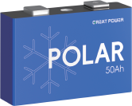
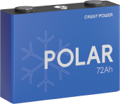
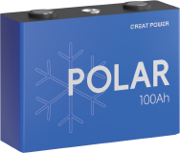
POLAR SERIES
^{M}mªo^{k}re^{in}s^{g}ta^{c}b^{le}lªe^{n}an^{en}d^{e}a^{r}c^{g}c^{y}essi^{f}b^{e}l^{r}e,
CELLS
50Ah
Low Temperature Residential Energy Storage Battery
Great Power has introduced the POLAR series in response to the challenges of battery applications in
Product model
GSP3914895F
low-temperature environments. This series can charge at temperatures as low as -30°C and discharge at -40°C.
Capacity
50 Ah
These batteries aim to meet the demand for battery resident usage in colder regions. We have overcome the
Nominal Voltage
3.2V
challenges in LFP material system, and with three core technologies—LTSC (Low-Temperature Super Conducting
Cycle Life
5000
Technology), micron-scale adaptive structures, and multi-dimensional copolymer bonding networks.
Cathode Material
LFP
Charging Temperature
-30~60℃
Discharge Temperature
-40~60℃
Storage Temperature
-40~60℃
^{T}Certi^{n}ﬁ^{g}c&ations
GB/T36276
UL1973 UL9540A IEC62619 RoHS Reach
UN38.3
72Ah
Product model
GSP39148107F
Capacity
72 Ah
Nominal Voltage
3.2V
Cycle Life
5000
Cathode Material
LFP
Charging Temperature
-30~60℃
Discharge Temperature
-40~60℃
Storage Temperature
-40~60℃
^{T}Certi^{n}ﬁ^{g}c&ations
GB/T36276
UL1973 UL9540A IEC62619 RoHS Reach
UN38.3
100Ah
Product model
GSP50160119F
Capacity
100 Ah
Nominal Voltage
3.2V
Cycle Life
5000
Cathode Material
LFP
Charging Temperature
-30~60℃
Discharge Temperature
-40~60℃
Storage Temperature
-40~60℃
^{T}Certi^{n}ﬁ^{g}c&ations
GB/T36276 UL1973 UL9540A UL1642 IEC62619 MSDS RoHS
UN38.3
29
30

Slide 17
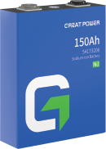
Making clean energy fer, more stable and accessible
Sodium-ion battery
SODIUM-ION BATTERY
150Ah
Great Power has initiated research on sodium-ion battery since 2019, achieving
Product model 54173206
signiﬁcant breakthroughs in 2021 in both two technology lines, layered oxide
Capacity 150 Ah
Charging/Discharging rate 0.5 C
Cycle life 3000@80%
Charging Temperature 0~45℃
and polyanions. The next year, in 2022, the company achieved small-scale trial
production of sodium-ion batteries, which were tested in EVs.
In 2023, the company's SiBs passed battery evaluations conducted by the China
Electronics Standardization Institute, becoming one of the ﬁrst companies in
Discharging Temperature
-40~60℃
r_{E}e_{V}si_{b}d_{a}e_{t}n_{te}t_{r}ia_{y}l storage,
the country to pass sodium-ion battery assessments. Additionally, Great Power
Applications
has actively participated in discussions and formulation of China's sodium-ion
battery standards. In July of the same year, Great Power signed a sodium-ion battery energy storage power station demonstration project with the Qingdao Beian Holding Big Data Center, which marks Great Power's sodium-ion batteries into industrial commercialization.
In 2024, Great Power made signiﬁcant advancements in sodium-ion Battery technology. The new generation of SiBs has demonstrated improvements in safety performance, energy density, and capacity. Great Power has oﬃcially
launched two sodium-ion Batteries: a 150Ah prismatic cell and a 3.05Ah small
3.05Ah
cylindrical battery.
Product model 26650
Capacity 3.05 Ah
Charging/Discharging rate 0.5 C
Cycle life 3000@80%
Charging Temperature 0~45℃
Discharging Temperature -40~60℃
Applications
residential storage,
EV battery
31
32

Slide 18
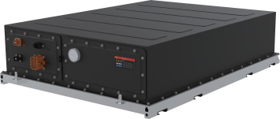
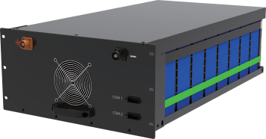
Making clean energy fer,
more stable and accessible
Pack
Pack
52 1
LiqPack-280Ah 1P48S AirPack-280Ah 1P16S
AirPack-150Ah 1P24S
Liquid-cooled pack
Suitable for container and cabinet energy storage systems
·
diﬀusion
·
stability and reliability
·
diﬀusion at temperatures up to 1000℃
· Air-cooled pack
· Great ﬂow channel design optimized through thermal
· Suitable for container and cabinet energy storage
simulation technology
systems
· High safety standard: UL 9540A
· Mature technology
· High protection level: IP 67
· Aﬀordable cost
· Worldwide certiﬁcations: UL9540A, UL1973, IEC62619,
· Protection level: IP2X
IEC61000 and UN38.3
· Transportation standard: UN383.3
Product Type
LiqPack-280Ah 1P52S
LiqPack-280Ah 1P48S
Product Type
AirPack-150Ah 2P12S AirPack-280Ah 1P16S AirPack-150Ah 1P24S
Cell Capacity
280 Ah
280 Ah
Cell Capacity
150 Ah
280 Ah
150 Ah
Conﬁguration
1P 52S
1P 48S
Conﬁguration
2P 12S
1P 16S
1P 24S
Charging/Discharging Rate
0.5 C
0.5 C
Charging/Discharging Rate
0.5 C
0.5 C
1.0 C
Cooling Method
Liquid cooling
Liquid cooling
Cooling Method
Air cooling
Air cooling
Air cooling
Rated Capacity
280Ah@0.5C
280Ah@0.5C
Rated Capacity
150Ah@0.5C
280Ah@0.5C
150Ah@1.0C
Battery System Voltage
1000/1500 Vd.c.
1000/1500 Vd.c.
Battery System Voltage
1000 Vd.c.
1000/1500 Vd.c.
1000/1500Vd.c.
Rated Energy
46.592 kWh
43.008 kWh
Rated Energy
11.52 kWh
14.336 kWh
11.52 kWh
Protection Level
IP67
IP67
Protection Level
IP2X
IP2X
IP2X
Dimensions
W786×D1141×H251.5 mm
W786×D1068×H251.5 mm
Dimensions
W450.5×D693*H242 mm
W470×D833×H225 mm
W470×D785×H225 mm
Product Weight
≈360 Kg
≈330 Kg
Product Weight
≈99 Kg
≈113 Kg
≈96.5 Kg
Maritime Standard
Applications
UN38.3
Container or Cabinet
UN38.3
Container or Cabinet
Maritime Standard
Applications
UN38.3
Container or Cabinet
N/A
Container or Cabinet
UN38.3
Container or Cabinet
Testing&Certiﬁcations
GB/T36276 UL1973 UL9540A IEC62619 IEC61000
UN38.3
UL1973 UL9540A IEC62619 IEC61000 IEC62040
UN38.3
Testing&Certiﬁcations
GB/T36276
GB/T36276
IEC62619 IEC61000 UN38.3
33
34

Slide 19
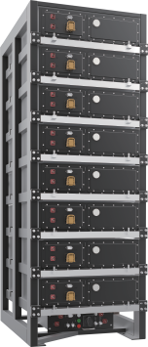
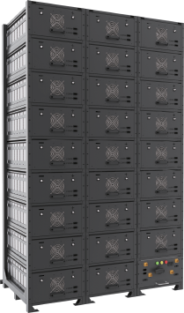
^{M}mªo^{k}re^{in}s^{g}ta^{c}b^{le}lªe^{n}an^{en}d^{e}a^{r}c^{g}c^{y}essi^{f}b^{e}l^{r}e,
Rack
Rack
416 28 41
LiqRack-280Ah 1P384S AirRack-150Ah 1P360S
Liquid-cooled pack in parallel
Suitable for container energy storage systems
Modular design, easy application combination
Thermal insulation between cells, eliminating heat diﬀusion
·
stability and reliability
· Air-cooled pack in parallel
· Great ﬂow channel design optimized through thermal
· Suitable for container energy storage systems
simulation technology
· High safety, mature technology, reliability, and low cost
· 20% longer cycle life compared to air cooled
· Modular design, easy to application combination, install,
· Wide operating temperature range, from -40 ℃ to 60℃
and maintain.
· High protection level: IP 67
· High-rate capability, supports up to 1C.
Product Type
LiqRack-280Ah 1P416S
LiqRack-280Ah 1P384S
Product Type
AirRack-280Ah 1P416S
AirRack-150Ah 1P360s
Charge/Discharge Rate of The Pack
0.5C
0.5 C
Charge/Discharge Rate of The Pack
0.5 C
1 C
Conﬁguration
1P416S
1P 384S
Conﬁguration
1P 416S
1P 360S
Nominal Voltage
1331.2 V
1228.8 V
Nominal Voltage
1331.2 V
1152 V
Working Voltage Range
900-1500Vd.c.
900-1500 Vd.c.
Working Voltage Range
900-1500 Vd.c.
900-1500 Vd.c.
Rated Capacity
280 Ah
280 Ah
Rated Capacity
280 Ah
150 Ah
Rated Energy
372.7 kWh
344 kWh
Rated Energy
372.7 kWh
172.8 kWh
Dimensions
W860×D1153×H2333 mm
W860×D1080×H2333 mm
Dimensions
W1442×D835×H2418 mm
W960×D788×H2341 mm
Product Weight
≈3200 Kg
≈3000 Kg
Product Weight
≈3200 Kg
≈1700 Kg
Pack Type
LiqPack-1P52S
LiqPack-1P48S
Pack Type
AirPack-1P16S
AirPack-1P24S
Functional Safety
Applications
Class B
Container
Class B
Container
Functional Safety
Applications
Class B
Container
Class B
Container
Testing&Certiﬁcations
IEC62619 IEC62619 UL1642 UL1973
GB/T36276 IEC62619 IEC61000 UL1642 UL1973
Testing&Certiﬁcations
GB/T36276
IEC62619 IEC61000
35
36

Slide 20
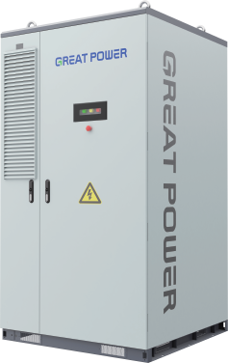
^{M}mªo^{k}re^{in}s^{g}ta^{c}b^{le}lªe^{n}an^{en}d^{e}a^{r}c^{g}c^{y}essi^{f}b^{e}l^{r}e,
DC OUTDOOR BATTERY SYSTEM
DC OUTDOOR BATTERY SYSTEM
Magna-UTL-373
Magna-UTL-418
Application scenarios: industrial parks, zero-carbon parks, production factories,
Application scenarios: industrial parks, zero-carbon parks, production factories,
green transportation, commercial services, data centers, and other high-power
green transportation, commercial services, data centers, and other high-power
consumption settings.
Product advantages:
consumption settings.
Product advantages:
·Enhanced Safety: Prevents thermal runaway in battery cells and safely connects
·High safety: Passes UL9540A Unit-level test, preventing thermal runaway of
wi h PCS without risks of circulating currents or int r-cluster short circuits.
_{o}ba_{r} t_{i}t_{n}e_{t}r_{e}y_{r-}c_{c}e_{lu}ll_{ste}C_{r}a_{s}n_{h}c_{o}o_{r}n_{t} n_{ci}e_{rc}t_{u}i_{i}n_{ts}s. eries with PCS without risks of circulating current
·Extended Lifespan: The liquid cooling system keeps the core temperature
diﬀerence below 2℃, enhancing cycle lif by 30%.
·Long lifespan: Liquid cooling system maintains core temperature diﬀerence <2℃,
·Flexible Scalability: Oﬀers an alternative to traditional container solutions,
·increasing cycle life by 30%.
·^{e}S^{n}im^{ab}p^{l}l^{i}i^{n}ﬁ^{g}ed^{ad}Inªs^{p}t^{t}aªl^{b}la^{l}t^{e}io^{la}n^{y}:ºE^{u}a^{t}c^{s}h. unit is under 4 tons, allowing for easy hoisting
scalability: R places co ain solutions, allowing for ﬂexible layout.
and on- te se p.
·Easy to be installed: Each unit weighs under 4 tons, facilitating on-site hoisting
·Eﬀortless Maintenance: Modular design ensures straightforward and convenient
and installatio .
on-site servicing.
·Easy maintenance: Modular design for convenient on-site maintenance.
Product Type
Magna-UTL-373
Product Type
Magna-UTL-418
Product Category
DC Outdoor Liquid-cooling Battery System
Product Category
DC Outdoor Liquid-cooling Battery System
Rated Energy
372.7kWh@0.5C
Rated Energy
418kWh@0.5C
Rated Power
180 kW
Rated Power
Max 209 kW
Rated Output Voltage
900-1500 Vd.c.
Rated Output Voltage
900-1500 Vd.c.
Cell Capacity
280 Ah
Cell Capacity
314 Ah
Cell Type
LFP
Cell Type
LFP
Conﬁguration
1P 416S
Conﬁguration
1P 416S
Discharge Current
140 A
Discharge Current
157 A
Charging Current
140 A
Charging Current
157 A
Charging Temperature
0~45℃
Charging Temperature
0~45℃
Discharging Temperature
-20~50℃
Discharging Temperature
-20~50℃
Communication Port
CAN、485
Communication Port
CAN、485
Cooling Method
Liquid Cooling
Cooling Method
Liquid Cooling
Protection Level
IP55
Protection Level
IP55
Functional Safety
class B
Functional Safety
class B
Product Weight
≈4000 Kg
Product Weight
≈4100 Kg
Dimensions
W1300×D1300×H2365 mm
Dimensions
W1300×D1300×H2365 mm
Applications
Utility-scale, C&I
Applications
Utility-scale, C&I
Testing&Certiﬁcations
IEC62619 IEC62933 IEC61000 UL1973 UL9540A
Testing&Certiﬁcations
37
38

Slide 21
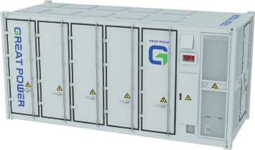
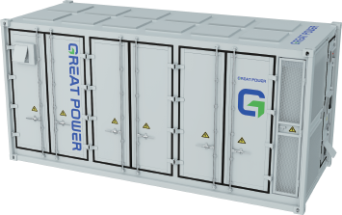
^{M}mªo^{k}re^{in}s^{g}ta^{c}b^{le}lªe^{n}an^{en}d^{e}a^{r}c^{g}c^{y}essi^{f}b^{e}l^{r}e,
CONTAINER ENERGY
CONTAINER ENERGY
STORAGE SOLUTION
STORAGE SOLUTION
Max-20HC-3440
Max-20HC-5000
Electric power scenarios:
Electric power scenarios:
Wind or photovoltaic power generation.
Wind or photovoltaic power generation, and regions
Suitable for regions with signiﬁcant peak-valley price
with signiﬁcant peak-valley price diﬀerences or large
diﬀerences and areas with large ﬂuctuations in daily load.
High safety: Compliant with UL9540A standards.
load ﬂuctuations.
Product advantages:
Product advantages:
High safety: Compliant with UL9540A, NFPA855.
High ergy eﬃciency: >95% energy eﬃciency for DC
High energy eﬃciency: Battery cell eﬃciency ≥96%;
charge and discharge.
RTE 96% @ 0.25p, 95% @ 0.5p on the DC side.
Long lifespan: Designed for a 15-year service life with a
Easy to be installed: Integrated design in a 20 gp
30% increase in battery lifespan.
container.
High returns: Oﬀers high energy density and integration
High p otection: IP55 erall, IP67 for Battery Pack,
for increased life cycle returns.
IP54 for High-voltage box, IPX5 for Electrical compart-
Easy to be installed: Highly integrated design for simple
ment.
scalability and installation; supports third-party SCADA
Cost-eﬀective: 50% increase in energy density for
and cloud-based EMS integration.
enhanced life cycle returns.
Product Type
Max-20HC-3440
Product Type
Max-20HC-5000
Product Category
20HC DC liquid-cooling container energy storage solution
Product Category
20HC DC liquid-cooling container energy storage solution
Rated Energy
3.44MWh@0.5C
Rated Energy
5.0MWh@0.5C
Rated Power
180kW*10/1.7MW
Rated Power
≤417kW*6/1.25MW*2
Rated Output Voltage
900-1500 Vd.c.
Rated Output Voltage
1040-1500 Vd.c.
Cell Capacity
280 Ah
Cell Capacity
314 Ah
Cell Type
LFP
Cell Type
LFP
Conﬁguration
1P384S*(10 or 9 or 8)
Conﬁguration
1P416S*12
Maximum Discharge Current
173 A*(10 or 9 or 8)
Maximum Discharge Current
157 A*12
Maximum Charging Current
173 A*(10 or 9 or 8)
Maximum Charging Current
193 A*12@5min
Charging Temperature
0~45℃
Charging Temperature
-30~+50℃
Discharging Temperature
-20~50℃
Discharging Temperature
-35~+60℃
Communication Port
CAN、485、TCP/IP
Communication Port
CAN、RS485、RJ45/Optical ﬁber
Cooling Method
Liquid Cooling
Cooling Method
Liquid Cooling
Protection Level
IP54
Protection Level
IP55
Functional Safety
class B
Functional Safety
class B
Product Weight
＜36T
Product Weight
＜42T
Dimensions
W6058*D2438*H2896 mm (20HC)
Dimensions
W6058*D2438*H2896 mm (20HC)
Applications
Utility-scale, C&I
Applications
Utility-scale, C&I
Testing&Certiﬁcations
GB/T36276 IEC62619 IEC62933 IEC61000 UL1973 UL9540A
Testing&Certiﬁcations
GB/T36276 IEC62619 IEC62933 IEC61000 UL1973 UL9540A
39
40

Slide 22
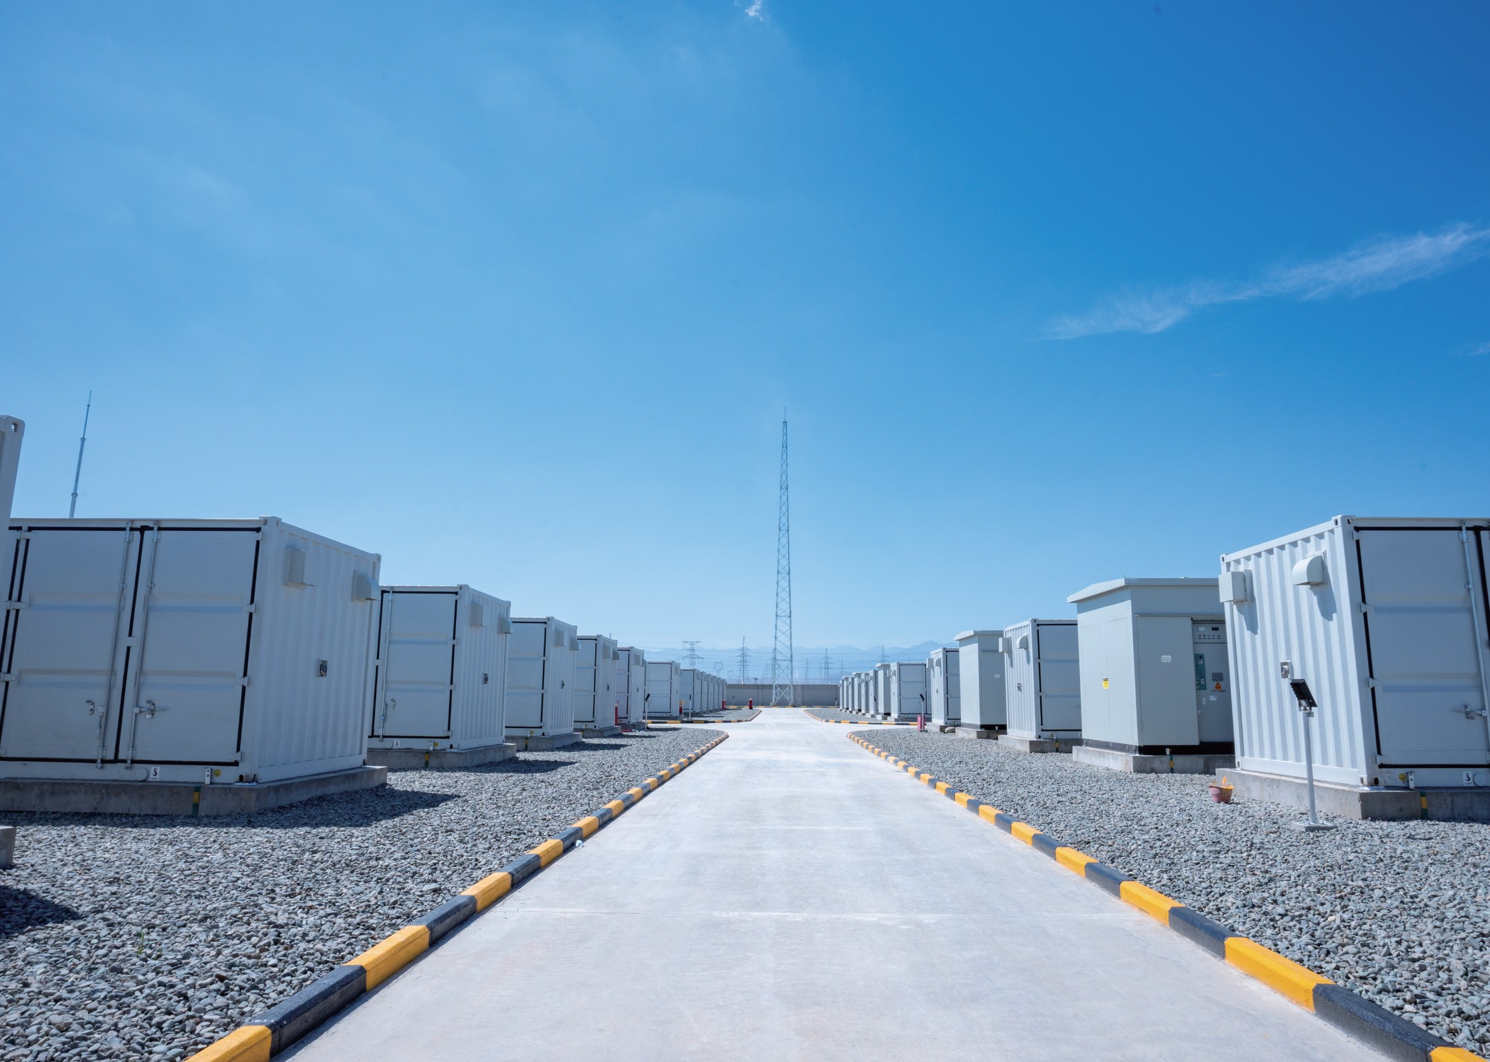
^{M}mªo^{k}re^{in}s^{g}ta^{c}b^{le}lªe^{n}an^{en}d^{e}a^{r}c^{g}c^{y}essi^{f}b^{e}l^{r}e,
REFERENCE PROJECTS
23Years 1000
0 50+
K+sets
experience in
Over 1000k sets of energy storage
accidents countries/areas
lithium-ion battery
products installed
technology & manufacturing
41
42

Slide 23
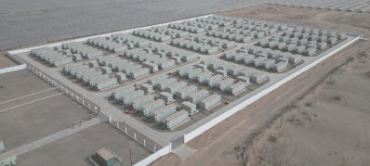
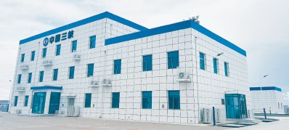
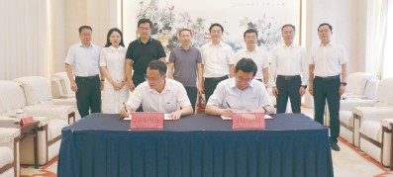
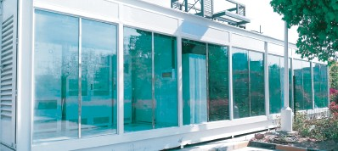
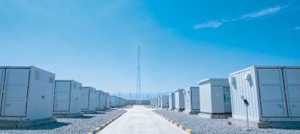
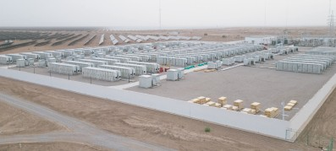
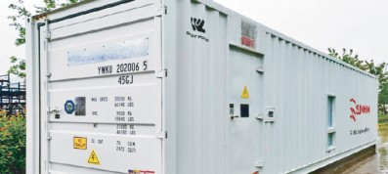
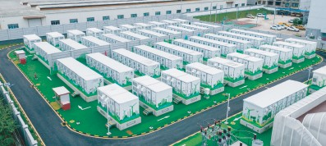
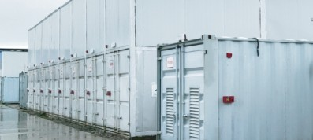
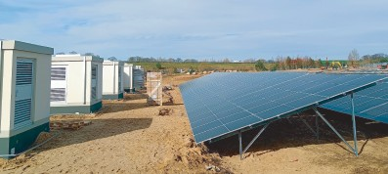
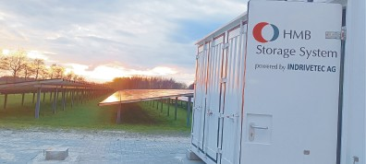
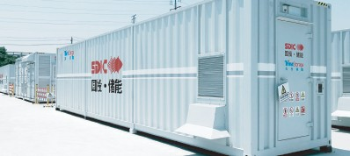
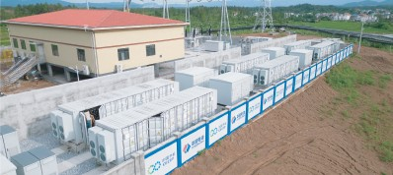
^{M}mªo^{k}re^{in}s^{g}ta^{c}b^{le}lªe^{n}an^{en}d^{e}a^{r}c^{g}c^{y}essi^{f}b^{e}l^{r}e,
GLOBAL REFERENCE PROJECTS
GLOBAL REFERENCE PROJECTS
CNPC's Tarim Oilﬁeld 600MWh
Ulanqab 180MWh
Qingdao Sodium-Ion 10MWh Project
SAIC-GM-Wuling 1MWh
Photovoltaic Power Generation Project
Green Power Station Demonstration Project
(Under Construction)
Step-Utilization ESS Project
Jimusaer 150MWh Project
Bachu 140MWh
Kangding 392kWh
Croatia 17MWh
Agro-Photovoltaic Complementary Project
Photovoltaic Oﬀ-grid Energy Storage Project
Photovoltaic and Storage Complementary Project
Nanning 100MWh Energy Storage Project
State-Owned Shipyard 100MWh
Germany 16.77MWh
The Netherlands Emmen 3.6MWh
Energy Storage Station Project
Containerized Energy Storage Project
Photovoltaic and Storage Complementary Project
DL Industrial Park 80MWh
Ji'an 15MWh
India 2MWh
Japan UBE factory in Osaka 6MWh Project
Energy Storage Station Project
Agro-Photovoltaic Complementary Project
High-Grid Photovoltaic Storage Project
43
44

Slide 24
^{M}mªo^{k}re^{in}s^{g}ta^{c}b^{le}lªe^{n}an^{en}d^{e}a^{r}c^{g}c^{y}essi^{f}b^{e}l^{r}e,
GLOBAL REFERENCE PROJECTS
GLOBAL REFERENCE PROJECTS
Shenzhen Bus Charging Station 60MWh Project
Zhejiang Xianhe New Energy Co., LTD. 44.72MWh
Henan Zhongyuan Internal Combustion Parts Co., Ltd.
Henan Mingsheng New Materials Technology Co., Ltd.
Energy Storage Project
40MWh Project
30MWh Project
Zhuhai Great Power Production 29.77MWh Project
Guangzhou Production 7.33MWh Project
Henan Jinli Jin Lead Group Co., Ltd. 24MWh Project
Jiangsu Changzhou Hutang Technology Park
10.32MWh Project
Henan Jinma Energy Co., Ltd.
Guangzhou Weili Medical Equipment Co., Ltd.
Foshan Shunde Keli Non-Ferrous Metals Co., Ltd.
Guangzhou Huasheng Acoustics Co., Ltd.
34.4MWh Energy Storage Project
7.95MWh Project
5.2MWh Project
4MWh Project
Guangdong Yunfu Xianfeng Stainless Steel
Guangzhou Xinli 2.33MWh Project
Guangdong Zhuhai 520kWh Solar-Storage-Charging
Henan Zhumadian CIMC Huajun Automobile Co., Ltd.
45
Products Co., Ltd. 4.3MWh Energy Storage Project
Integrated Supercharging Station Project
2.8MWh Project
46

Slide 25
CONTACT US
Guangzhou Great Power Energy & Technology Co., Ltd
Great Power NA Oﬃce
(Headquarters)
3146B Sports Arena Blvd #1049 San Diego
Great Power EU Oﬃce
Address: No. 912 Shiliang Road, Shawan town, Panyu District,
Guangzhou, China
Königstraße 35
Tel: +86 020 3919 6888
Zhuhai Great Power Energy Co., Ltd.
70173 Stuttgart Germany
Great Power Indonesian Oﬃce
Address: Xinqing Fifth Road, Xinqing Technology Industrial Park,
Soho Capital Unit SC-4005A Podomoro City, Jl. Letjen S.
Doumen town, Zhuhai, China
Parman, Desa/Kelurahan Tanjung Duren Selatan, Kec.
Henan Great Power Energy Co., Ltd.
Grogol Petamburan, Kota Adm. Jakarta Barat, Provinsi
Address: Intersection of Zhongyuan Avenue and Huaihe Avenue,
DKI Jakarta
Zhumadianyi, China
Great Power Singapore Oﬃce
Liuzhou Great Power Energy & Technology Co., Ltd.
Address: 2 Venture Drive, #24-01, Vision Exchange,
Address: No. 18 Yangliu Road, Liubei District, Liuzhou, China
Foshan Shida Battery Technology Co., Ltd.
Singapore 608526
Great Power Japanese Oﬃce
Address: No. 30 Xingye Road, Zone C of Shishan Science and
36-4-3, Kamikobata-cho, Sabae-shi, Fukui-ken, Japan
Great Power Chile Oﬃce
Technology Industrial Park, Foshan, China
Changzhou Great Power New Energy Technology Co., Ltd.
Address: 4611 Los Militares - Oﬃce 1016 - Las Condes
Address: No. 369 Xinghua Road, Jintan District, Changzhou, China
Quzhou Great Power Energy Technology Co., Ltd.
District - Metropolitan Region, Santiago, Chile.
Great Power Spain Oﬃce
Address: No. 59 Xiafei South Road, Quzhou, China
Address: Av. de Bruselas, 7, oﬃce 210, 28108 - Madrid,
Spain
Guangzhou Great Power Energy Storage Technology Co., Ltd.
Address: Room 003, No. 419 Qingsha Road, Dongchong town,
Reap Great Power Battery Technologies & Solutions
Nansha, Guangzhou, China
Anonim Şirketi (Great Power's Turkey SPV)
Address: Esentepe Mah. Kelebek Sk. Marmara Kule Sitesi
Qingdao Great Power Energy Technology Co., Ltd.
B Blok No: 2/1 iç Kapı No: 1 Kartal / istanbul, Türkiye.
The India Oﬃce (Under Construction)
Address:No. 569-174 Longhai Road, Hetao Street, Chengyang
District, Qingdao City, Shandong Province
Vietnam Great Power
Address: Factory C1 at Lot CN4-1 in Yen Phong II-C Industrial Park, Tam Giang Commune, Yen Phong District, Bac Ninh Province, Vietnam
47

